Slide 1
Elements of Reproducibility
Handing off your project and hoping it still works
Andy Boughton
Center for Statistical Genetics

Slide 2

University Research: An overview
Students build software
They write a paper that makes a bunch of promises
Students graduate
People use software and have questions
Flail and run around
Key personnel (students) depart at a predictable rate, and take knowledge with them. What does this mean for community resources?
“Data Sharing and management snafu in 3 short acts” - https://www.youtube.com/watch?v=66oNv_DJuPc

Slide 3
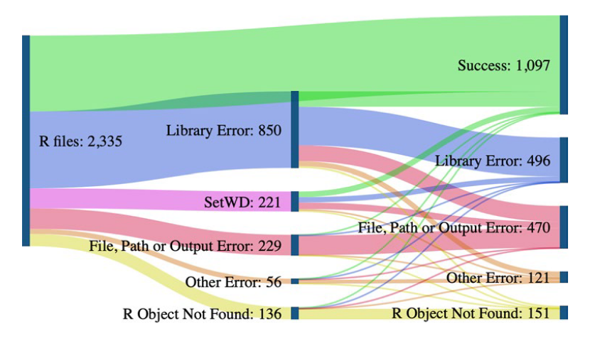
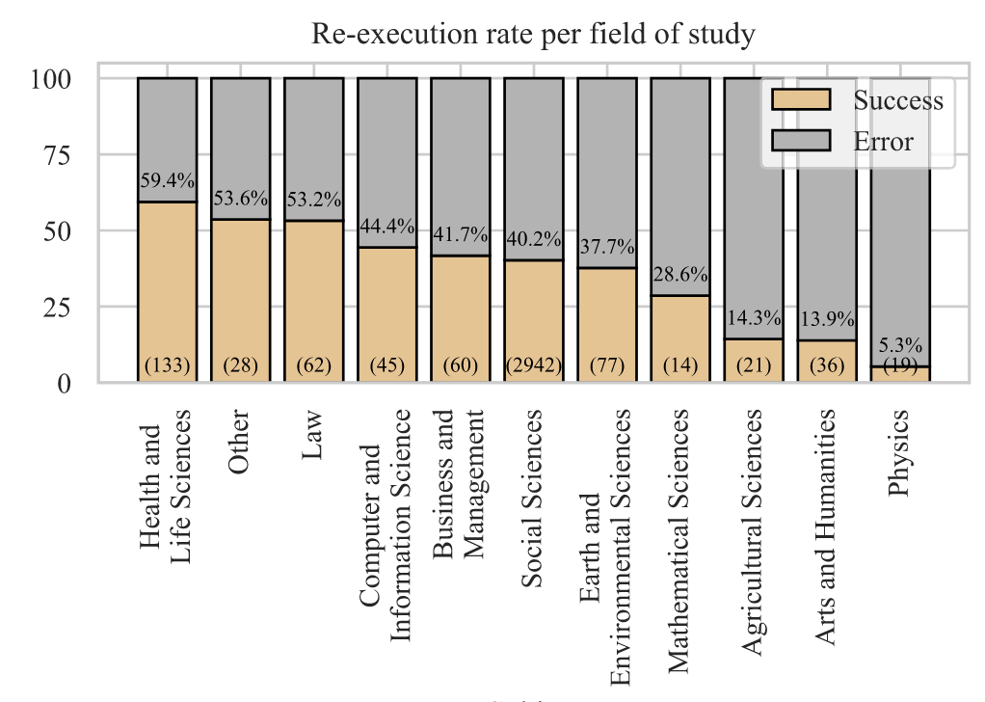
“...more than 2000 replication datasets... execute[d] ... in a clean runtime environment... 74% of R files failed to complete without error in the initial execution, while 56% failed when code cleaning was applied...
...our automated study has a comparable success rate to the reported manual reproducibility....”
“...mandated data archiving policies that require the inclusion of a data availability statement in the manuscript improve the odds of finding the data online almost 1000-fold compared to having no policy... rates at journals with less stringent policies were only very slightly higher than those with no policy at all.”
Trisovic, A. et al. A large-scale study on research code quality and execution. Sci Data 9, 60 (2022). DOI: 10.1038/s41597-022-01143-6
Vines, T. H. et al. Mandated data archiving greatly improves access to research data. FASEB j. 27, 1304–1308 (2013). DOI: 10.1096/fj.12-218164
Notes:
The most impactful “auto fixes” included:
badly/ under-specified dependencies
system-dependent file paths
The Nature study just assessed whether code ran, not whether it got same results as the paper! Other reproducibility studies tackle the latter problem. Even once you get the code running, the picture for reproducibility is still quite bleak.

Slide 4
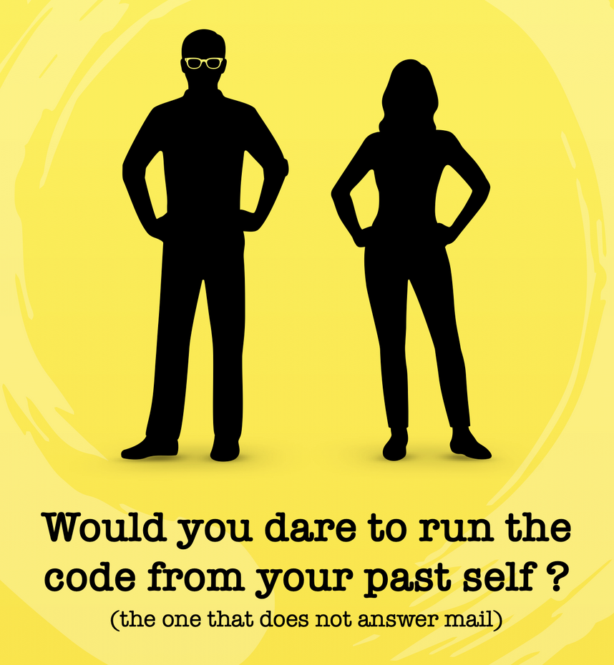
“...Over 95% of sites were running in the first 2 years, but this rate dropped to 84% in the third year and gradually sank afterwards (P < 1e-16). The mean half-life of Web services is 10.39 years. Working Web services were published in journals with higher impact factors...”
“Krystalli runs workshops called ReproHacks for researchers to submit their own published papers, code and data, and challenge participants to reproduce it. Often, she says, they cannot...”
Ősz, Á., Pongor, L. S., Szirmai, D. & Győrffy, B. A snapshot of 3649 Web-based services published between 1994 and 2017 shows a decrease in availability after 2 years. Briefings in Bioinformatics 20, 1004–1010 (2019). DOI: 10.1093/bib/bbx159
Perkel, J. M. Challenge to scientists: does your ten-year-old code still run? Nature 584, 656–658 (2020). DOI: 10.1038/d41586-020-02462-7
Notes:
Many estimates of broken websites include static websites (just HTML). For interactive web sites, the number of things that work is probably lower, because there are more things that can break.

Slide 5
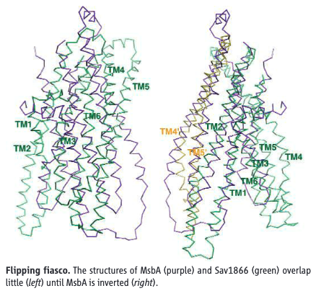
“a homemade data-analysis program had flipped two columns of data... Chang and his colleagues retract[ed] three Science papers and report that two papers in other journals also contain erroneous structures.
The ramifications of the software snafu extend beyond Chang’s lab... [others] had a hard time persuading journals to accept their bio-chemical studies that contradicted Chang’s MsbA structure. Those applications providing preliminary results that were not in agreement with the retracted papers were given a rough time...”
Miller, G. A Scientist’s Nightmare: Software Problem Leads to Five Retractions. Science 314, 1856–1857 (2006). DOI: 10.1126/science.314.5807.1856
Perkel, J. M. How to fix your scientific coding errors. Nature 602, 172–173 (2022). DOI: 10.1038/d41586-022-00217-0

Slide 6
Is this going to take a lot of work?
Answer: It depends

Slide 7
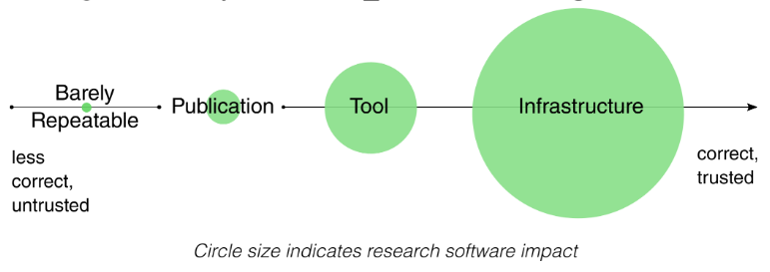
Harrison, S., Dasgupta, A., Waldman, S., Henderson, A. & Lovell, C. How reproducible should research software be? https://zenodo.org/record/4761866 (2021)
NASA Technology Readiness Levels: https://en.wikipedia.org/wiki/Technology_readiness_level

Slide 8
Levels of Preservation: What are your goals?
Living service
More work
Maintenance mode
More risk (if needed later)
Archival
https://www.software.ac.uk/resources/approaches-software-sustainability

Slide 9


Side note: Data and code have different needs
Software is more fragile to compile, but often smaller and easier to transfer than raw data
Some funding agencies require researchers to file a plan for how they will archive project data. Each field has unique rules
Tools exist to help create plans
https://dmptool.org/
https://www.go-fair.org/fair-principles/
Wilkinson, M. D. et al. The FAIR Guiding Principles for scientific data management and stewardship. Sci Data 3, 160018 (2016). 10.1038/sdata.2016.18

Slide 10

Archiving software
Baseline preservation for any project

Slide 11
A focus on what and how
An archival project is not expected to receive new features or support; “at your own risk”
Interested parties may have to rewrite the software to carry it forward
Focus on scientific reproducibility: if an error is found, allow future readers to know what happened and why
BUT: If you promise that your tool can be used by others, then there are additional requirements...

Slide 12
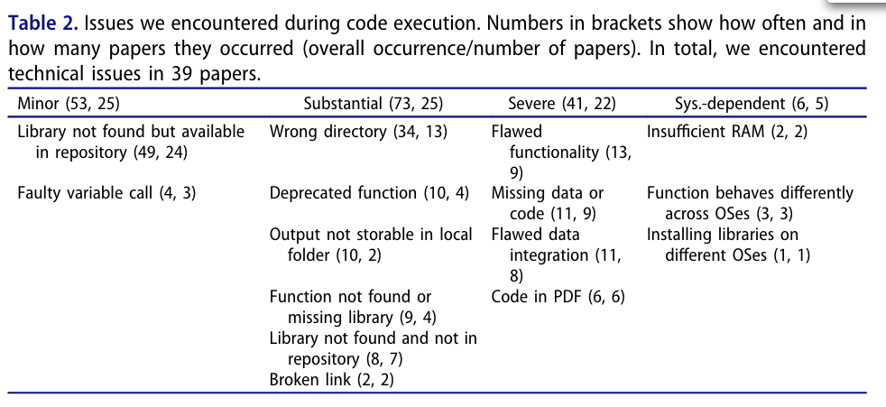
Konkol, M., Kray, C. & Pfeiffer, M. Computational reproducibility in geoscientific papers: Insights from a series of studies with geoscientists and a reproduction study. International Journal of Geographical Information Science 33, 408–429 (2019). 10.1080/13658816.2018.1508687
Notes:
I deliberately cite many different papers on the same topic, because the problems of irreproducible software are widespread!

Slide 13


Make it findable
GitHub is a popular place to store and share “living” code
Private repos exist- you can start using version control before you are ready to publish
Useful tips:
Before you publish, transfer to our organization so that people can release bugfixes to the “official” URL in the paper [1]
Tag your releases so that people can see exact version used for a paper [2]
If you are publishing code or data as a separate item, Zenodo handles archiving and gives a citable DOI. Can create from GitHub repo!
[1] https://github.com/statgen
[2] git tag v1.0 –a && git push --tags
https://docs.github.com/en/repositories/archiving-a-github-repository/referencing-and-citing-content

Slide 14
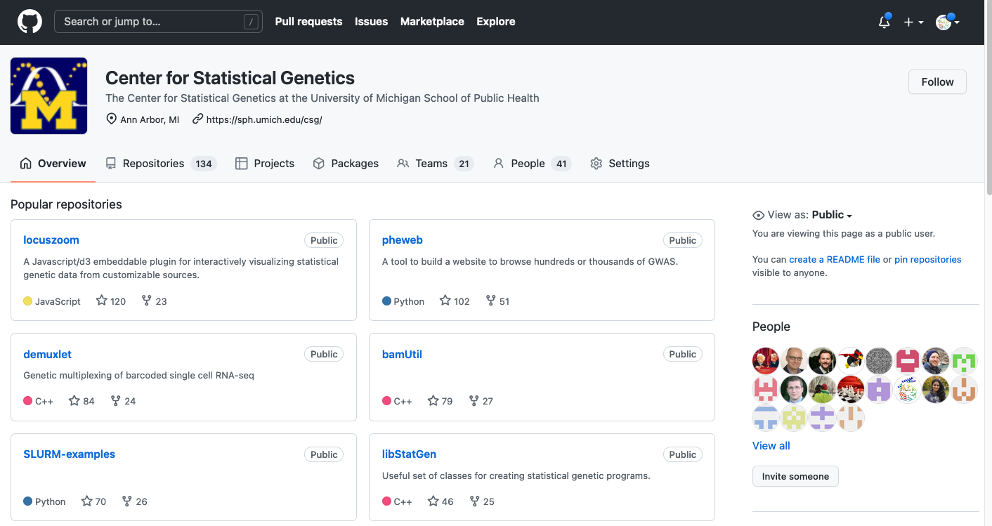
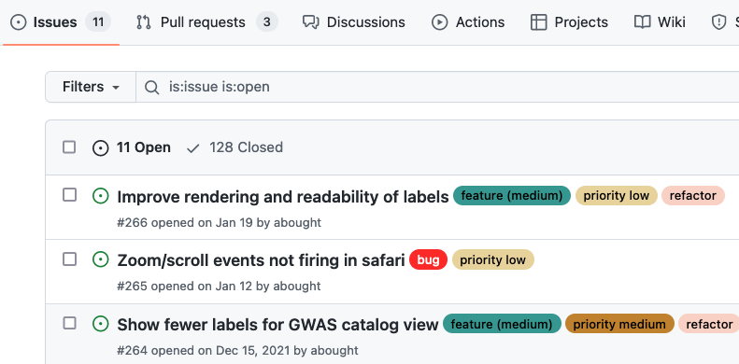
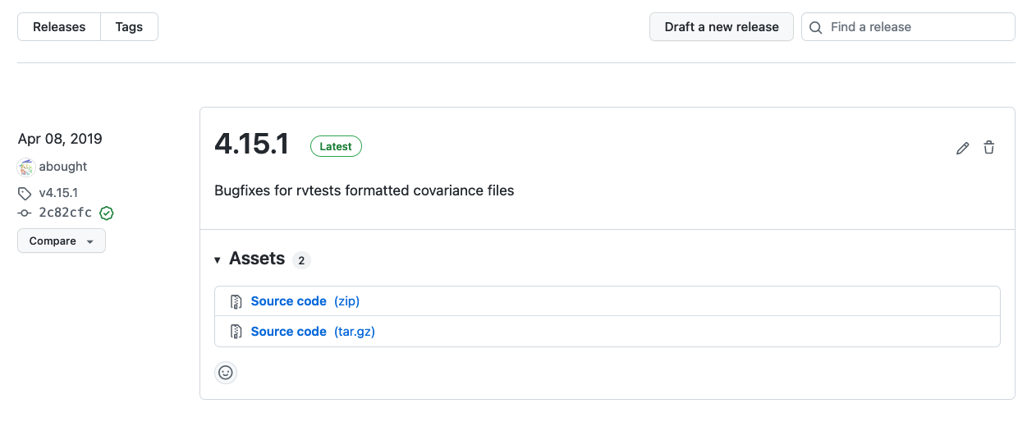
https://github.com/statgen/

Slide 15

Help people to use your archive
Contains exact code, not just a prose description of methods
Clean up dead code, broken methods, or “test” files
Tag releases if your program changes over time
Good archives start with good development habits. Don’t wait until the end!
Taschuk, M. & Wilson, G. Ten simple rules for making research software more robust. PLoS Comput Biol 13, e1005412 (2017). DOI: 10.1371/journal.pcbi.1005412

Slide 16










Capture the environment
Much of the behavior of code is driven by external factors
Avoid hard-coded paths like “/User/broken_for_you/Documents”
Specify exact required dependencies using a dependency manager
Data matters!
Include a small test dataset to run the program
Provide example configuration or parameter files with critical options
Consider containers (Docker, Singularity, etc) to distribute dependencies along with the program
Be able to follow your own setup instructions on a new computer
cget

Slide 17
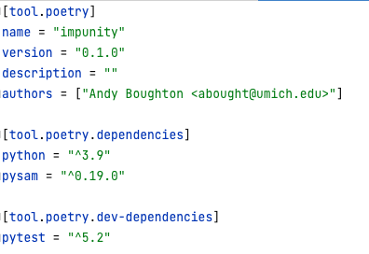
Package managers: What to look for
Metadata: who and what
Dependencies: What is required to run?
Dev dependencies: extra stuff if you’re modifying the code
Track versions used- packages change over time
Semver: allow your package to use slightly newer bugfix versions if they promise to be compatible (^, ~, *)
Lockfiles: track exactly what got installed, regardless of future updates
Compare to old-style requirements.txt:
numpy
flask
matplotlib
?
?
?
https://python-poetry.org/docs/dependency-specification/

Slide 18





Automation tells you what is true*
As you develop, automate your routine validation steps via test frameworks + continuous integration (eg pytest + GitHub actions)
Instead of a markdown file specifying commands that are out of date, use bash scripts or workflow tools (makefile / snakemake)
For REST APIs, use an API framework that auto-generates documentation (eg OpenAPI format). (for CLIs, use argparse)
Instructions maintained by hand quickly become lies
GoogleTest
Example GitHub actions file for Python tests: https://github.com/abought/zorp/blob/develop/.github/workflows/pythonpackage.yml
Standard CLI tooling that auto-generates documentation: https://docs.python.org/3/library/argparse.html

Slide 19



Workflow automation tools
Imperative
Declarative
An exact list of commands to be run in order on a specific input
Markdown / text file
Hard to keep up to date; examples quickly stop working
In a process with many steps, you’ll probably forget one
Bash script
Runs the commands exactly as written, so it stays more up to date
... but unintuitive language rules can lead to bad things
Tell it the result you want (“out.txt”), and it decides what needs to be done
Efficient: Only re-run parts of the process where something has changed
Good when the amount of work to do is variable (“all files in folder”)
Examples: Make, snakemake, nextflow, workflowr
It takes time to learn a new language- start small and start early.
Back-automating a project at the end is much harder.

Slide 20
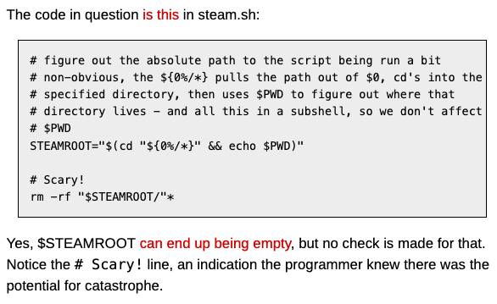
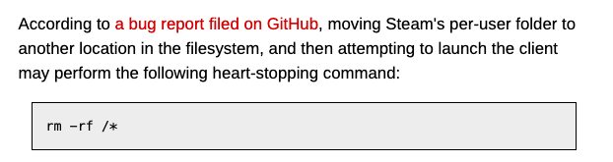
Pitfalls of bad automation
“
”
If your project has already committed to using Bash scripts...
Put this at the start of every .sh file: https://explainshell.com/explain?cmd=set+-eux
Sanity check scripts for common mistakes: https://github.com/koalaman/shellcheck
https://www.theregister.com/2015/01/17/scary_code_of_the_week_steam_cleans_linux_pcs/

Slide 21

Your archive should tell a story
Use example commands to provide an obvious starting point
Add value and remove distractions
Clean up dead code or unused files
Add example data (and file format docs)
Use source code comments to explain tricky bits
Add citations for unusual methods, or to explain how parameters were chosen
https://jupyter.org
https://rmarkdown.rstudio.com
https://en.wikipedia.org/wiki/Literate_programming
https://stackoverflow.blog/2021/12/23/best-practices-for-writing-code-comments/
https://selftaughtcoders.com/how-to-quickly-and-effectively-read-other-peoples-code/

Slide 22
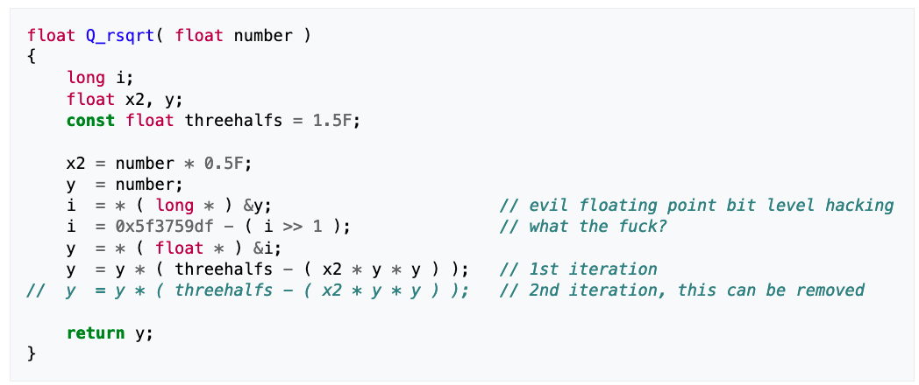
!@#$
https://en.wikipedia.org/wiki/Fast_inverse_square_root#Overview_of_the_code

Slide 23
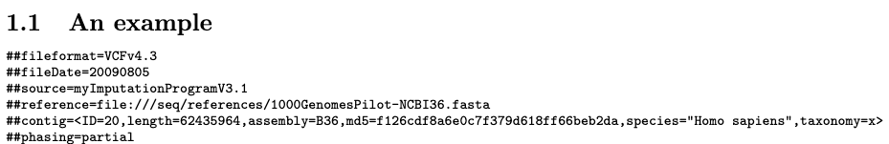
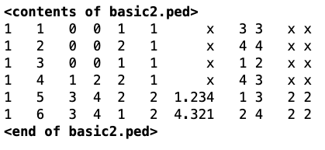
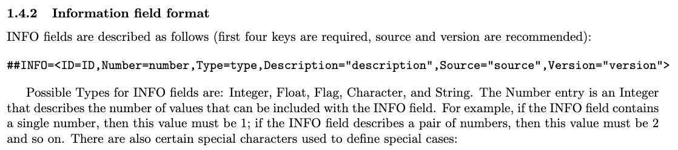
File formats: Open to interpretation
https://samtools.github.io/hts-specs/VCFv4.3.pdf
http://csg.sph.umich.edu/abecasis/merlin/tour/input_files.html

Slide 24
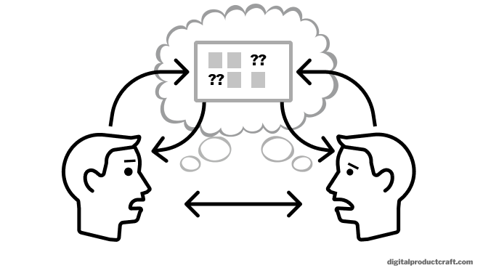
Externalizing ownership
All resources should be owned by the project, not one person
Mailing lists, Google Drive shared folders, domain names, etc
Key notes (including handoff documents) should not live in email, and test datasets should not live only in your user directory on a private project node
Inventory the services you depend on, and give someone access
Handoff documents are not written for the author. Have a friend try to use the instructions without your help*
* Then take your friend to lunch and apologize

Slide 25
Living projects
Sustaining momentum after you’re gone
Gardner, P. P. et al. Sustained software development, not number of citations or journal choice, is indicative of accurate bioinformatic software. http://biorxiv.org/lookup/doi/10.1101/092205 (2016) doi:10.1101/092205.

Slide 26
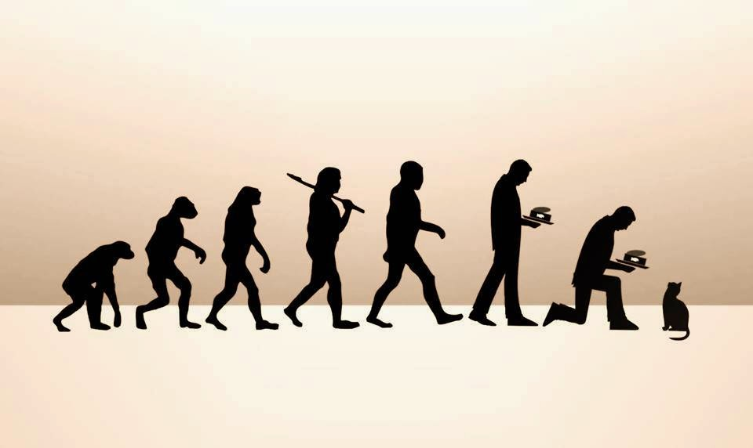
Recognize that needs may change
In a living project, no decision is final. Both maintenance and domain requirements are equally important
Do everything from the previous lists
Disaster recovery plans are no longer optional
Plan to revisit methods and implementation based on scale change
Without good requirements capture and process automation, the team will be crushed by maintenance of old stuff
Make sure that people with different expertise can work together
Cechova, M. Ten simple rules for biologists initiating a collaboration with computer scientists. PLoS Comput Biol 16, e1008281 (2020). https://journals.plos.org/ploscompbiol/article?id=10.1371/journal.pcbi.1008281

Slide 27
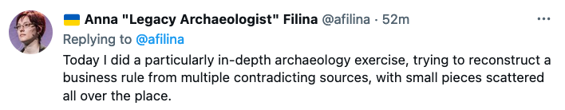

Slide 28
Barriers to collaboration
Brittle systems
Stuff that never actually worked (“did I create this bug?”)
Inaccurate documentation (“none of the sample commands work”)
No shared picture of reality
Lack of version control
Servers that are routinely edited by hand (test environments != production)
Secret or overly specialized knowledge
Bug reports and renewal notices go to former employee
Configuration-driven workflow systems whose behavior is only defined at deployment time, and cannot be inferred from code
No standard languages, tools, or habits
https://medium.com/capital-one-tech/lessons-from-the-leadership-trenches-how-do-i-choose-the-right-programming-language-for-my-team-36222aa78b38

Slide 29
Example: Languages I’ve worked with at CSG
Python (2 and 3)
Flask, Django/ DRF, FastAPI, pandas, jupyter, numpy, matplotlib
PHP (v5 and v7) (Frameworkless and partial adoption of Laravel)
JavaScript (ES5, ES2015+, node.js)
D3 (v3 and v5), JQuery, Vue.js, Backbone.js
Presentation layer: HTML, SVG, bootstrap 3-4, material UI, tailwind CSS
R
Go
Java
C++
Build/ dependency /automation/ deployment systems
Make, snakemake, cmake, bash scripts, Docker, some ansible
Webpack, babel, gulp, parcel, rollup, browserify, vue cli
pip, pipenv, poetry, conda, yarn, npm, go, cargo, cget, composer
Infrastructure environments
Google Cloud, AWS, on prem
Databases / Queryable storage
MySQL, PostGres, Sqlite, Mongo, Tabix, Parquet
Lack of a common team baseline is a hidden tax on productivity
Choose technologies that can be supported by your team after you leave
Learning is great, but no one wants to maintain your custom malbolge interpreter
Notes:
Having shared standards can help teams to be more productive, and remove the hidden tax on productivity that comes from frequent context switches

Slide 30
Sample archival checklist: CLI Tools
Code is available in a stable “source of record” (eg public version control)
Ensure that at least one other person can release “official” bugfixes
Tidy up: ADD comments / citations, and REMOVE unused code and files
Instructions can be followed without additional help
Code compiles and runs on a “clean” environment (eg docker or CI server)
Identify how to validate the software
Automate with small example test set if possible
Given same code and input files, can someone reproduce the figures in your paper?
Tag the version of code used to generate a paper
Externalize ownership
Have someone read and try the instructions
Provide an inventory of key resources and make sure someone else has access
Transfer ownership of mailing lists, shared documents, monitoring services, etc
GitHub organization: https://github.com/statgen/

Slide 31
Web Apps: sample inventory of key resources
Where to download key resource files
If access is required, identify point of contact (people are resources too!)
Provide a citation in case the FTP site is reorganized
Things not stored in version control
Configuration files, application secrets
External dependencies (Box/ Google Drive folders, Facebook/ Google Login, etc)
How to find AND obtain access to key services- give PI access as fallback
List of servers and databases + access credentials
Third party services (analytics, mailing lists, issue tracker, domain registrations)
Monitoring systems (Nagios, Sentry) and billing reminders
Grant PERMISSIONS, not just ACCESS. A locked console is not useful.
Process
Data dictionary for config/resource files: “the entire script depends on column 11, what’s that?”
Secret knowledge: “Things I check manually but never found time to automate”
Tips to the next person: “Stuff I think is worth doing in the future”
Critical files that you must be able to find fast (eg IRB documents)
Operations and disaster recovery
Standard operating procedures / automated scripts / service-specific repositories (Terraform, ansible, etc)
Call out key items that are time sensitive and can’t be ignored (billing alerts, IRB paperwork, domain renewals, etc)
Backups

Slide 32
Further reading
(*) Ten simple rules for making research software more robust - https://journals.plos.org/ploscompbiol/article?id=10.1371/journal.pcbi.1005412
(*) Good enough practices in scientific computing https://journals.plos.org/ploscompbiol/article?id=10.1371/journal.pcbi.1005510
(*) Ten simple rules for biologists initiating a collaboration with computer scientists https://journals.plos.org/ploscompbiol/article?id=10.1371/journal.pcbi.1008281
(*) Jeffrey Perkel – articles on scientific tools (Nature columnist): https://jeffreyperkel.com/publications/publications-nature/
JOSS review checklist: https://joss.readthedocs.io/en/latest/review_checklist.html
Best practices for writing code comments: https://stackoverflow.blog/2021/12/23/best-practices-for-writing-code-comments/
Data dictionary: https://library.ucmerced.edu/data-dictionaries

Slide 33
Hands-on opportunities
UMICH Software Carpentry - https://umcarpentries.org/
MIDAS events calendar: https://midas.umich.edu/calendar/
BIOSTAT R Workshops - https://sph.umich.edu/biostat/computing/r-programming-final.html
...many others!

Slide 34
Example “archival” projects
RP:CB data, methods, and analysis together - https://osf.io/nbryi/
METAL: Code, unit tests, tagged versions - https://github.com/statgen/METAL
Schloss lab manuscripts: Rmarkdown and snakemake workflows to generate the entire manuscript start to finish
http://www.schlosslab.org/papers/
Example: https://github.com/SchlossLab/Sovacool_OptiFit_mSphere_2022
JOSS archives: Peer-reviewed software repos - https://joss.theoj.org/
People are really doing this, and you can too

Slide 35
Places to archive things
Version Control: https://github.com/statgen/
Also provides public issue tracker for reporting bugs!
Citable DOIs for research articles: https://help.zenodo.org/features/
Or other domain specific hosting services (GWAS catalog, Figshare, Dataverse, OSF, etc)
Group wiki
https://genome.sph.umich.edu/wiki/
https://statgen.sph.umich.edu/wiki/
UMich services:
https://its.umich.edu/accounts-access/leaving
Shared accounts: https://documentation.its.umich.edu/node/501
MCommunity Groups: https://documentation.its.umich.edu/node/370

Slide 36
Summary
Archives should be self-contained
Don’t wait until the end for cleanup! Use good practices throughout the development process
Keep a record of key services and how to access them
Shared standards help people with different skills work together
Expect people to graduate, and plan ahead

Slide 37
Extra material
Some challenges in maintenance mode

Slide 38
Maintenance mode
Minor bugfixes and keeping the lights on

Slide 39

Know how to find things
Check your service inventory
Know how to find critical code, data, and infrastructure
Be able to interpret intent (“what is column 11 in this file? It seems important”)
Reference key points of contact
If key resources are restricted, who can give you access?
Are there special requirements (like IRB)?
Write stuff down while you still remember it!

Slide 40
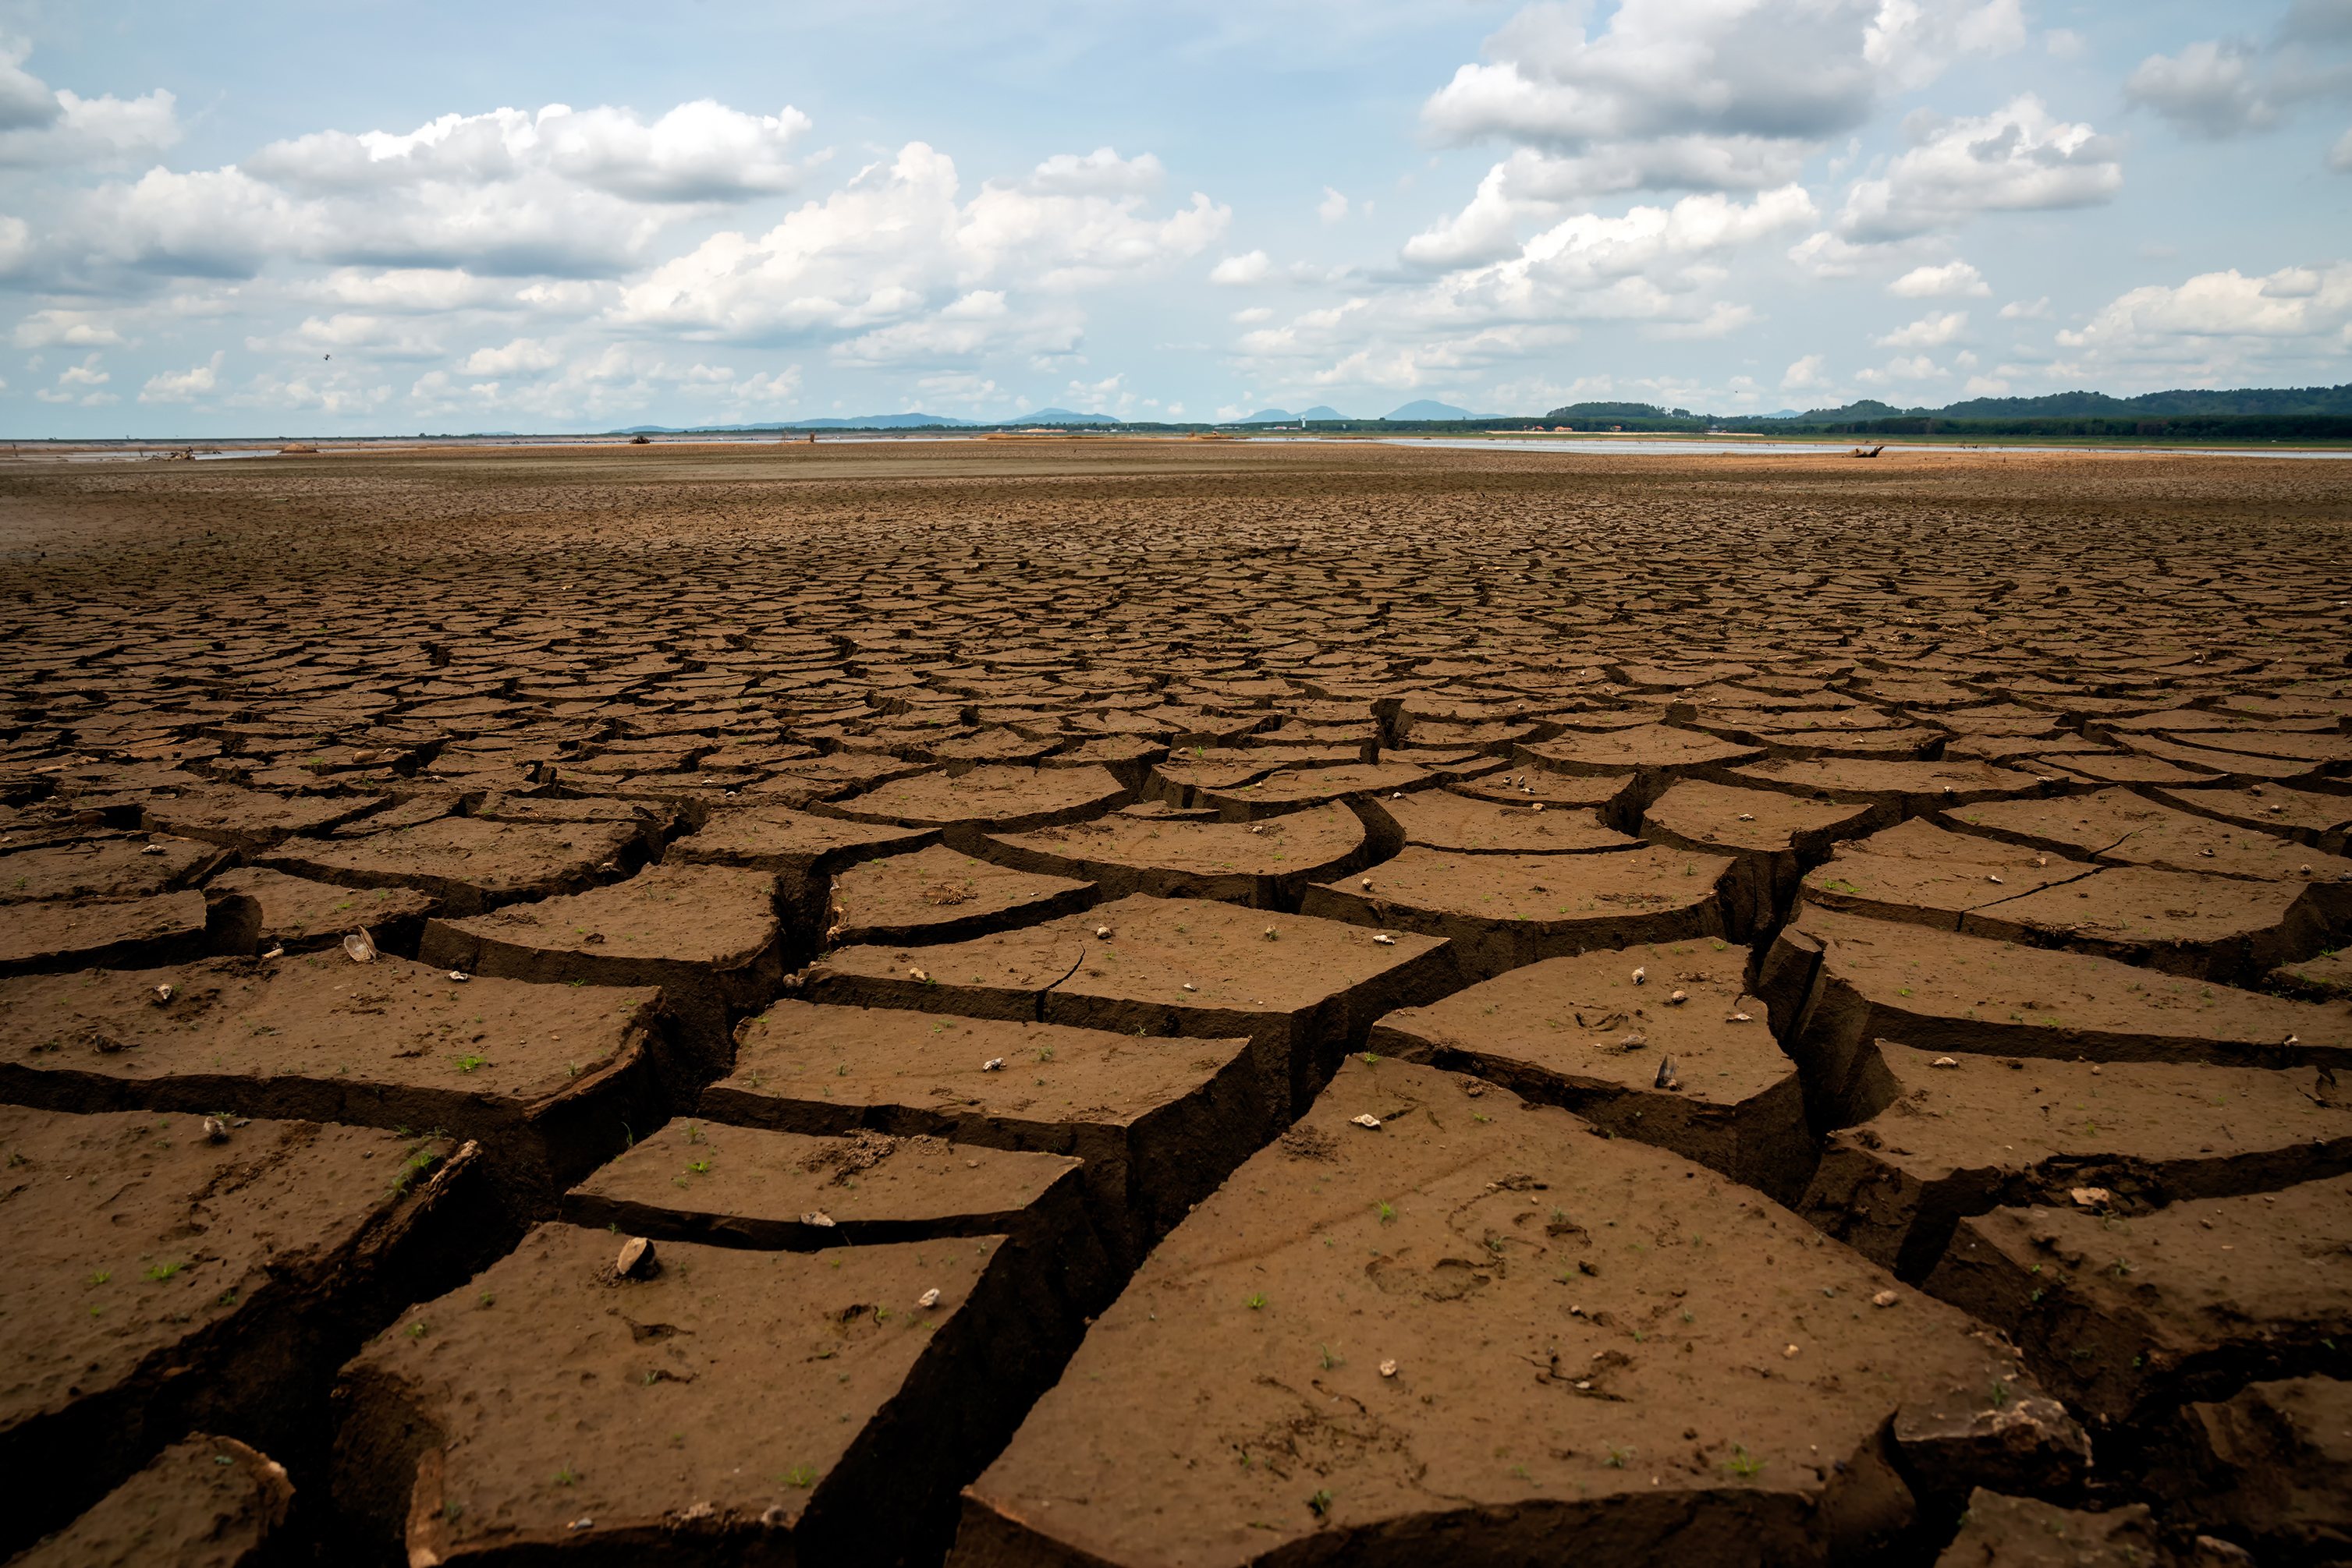
Things will break when left alone
Command line tools
Dependencies may change; pin versions you depend on
Data standards may change, or FTP sites may vanish- capture sample input
Web servers
Security updates must be installed, which could change how things work
Third party services may change or be turned off
Have a clear plan to validate new releases/ security updates
Automate as much as possible
“Data Sharing and Management Snafu in 3 short acts” - https://www.youtube.com/watch?v=66oNv_DJuPc
Notes:
Give your successor the ability to issue updates. Do not assume that a finished project will never need to be touched (“...it’s perfect, so I don’t need to document it! You’re welcome!”)

Slide 41



Know when to pay attention
Set clear priorities based on usage (“paper actively under review” vs “people only visit for nostalgia”)
Automated alerts tell you when something needs to be done
Some CSG machines have Nagios email alerts (examples: memory, disk usage, expired SSL certs, network issues, whether key processes are running)
Do not rely on users to report downtime. They rarely report bugs.
Mailing lists and public bug trackers let users reach “the project” regardless of who is currently responsible
Notes:
The key to successful maintenance mode is to be able to ignore the project as long as possible without disaster. Automated alerts tell you when attention is required, which can reduce the recurring workload.
As you identify frequent manual steps, use the opportunity to streamline things a little at a time.

Slide 42
Worst case scenario / Disaster Recovery
If the server breaks, is the project dead?
For a web site, make this decision early on, and communicate when it changes
Can a new environment be created automatically?
Can you find and generate critical data files from scratch?
Backups should be validated, frozen, and stored off site before you go into maintenance mode

Slide 43
“Hibernation” vs “Planned end date”
Not every project is a good candidate to be maintained indefinitely
Sensitive data must be protected
Unpatched machines could be exploited, and you would never know
Routine operations may have unforgiving deadlines
Missed domain renewal → anyone could impersonate a major research study
Missed IRB renewal → (...you don’t want to know)
Do not leave robots unattended
“Bring your own data” cloud services are a blank check against your bank account
Expect people to abuse your service eventually
https://www.wired.com/story/parler-hack-data-public-posts-images-video/
https://www.csoonline.com/article/3444488/equifax-data-breach-faq-what-happened-who-was-affected-what-was-the-impact.html
Notes:
If there are legal, ethical, or catastrophic financial implications, it may be better to end the service on your terms rather than ignoring it until disaster strikes.

